Slide 1
Mutual Information for Safe Data
2019-07-07

Slide 2
Background
The construction of PIF and Utility Factor has been based on the KL-Divergence metric.
The idea of Mutual Information (MI) was proposed by Team “Privately Concerned” in Round 1 of Directed Ideation on 3-July.
To support further exploration of the idea in the next round, the PIF and Utility Scripts have been updated to utilise MI instead of KL-Divergence.

Slide 3
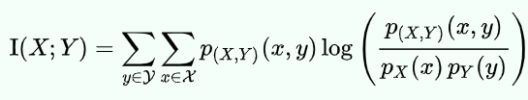
Mutual Information (MI)
The mutual information of two jointly discrete random variables X and Y is:
where p(X, Y) is the joint probability mass function of X and Y, and pX and pY are the marginal probability mass functions of X and Y respectively.
Note that for MI the joint probability p(X, Y) is needed for the computation of MI.

Slide 4
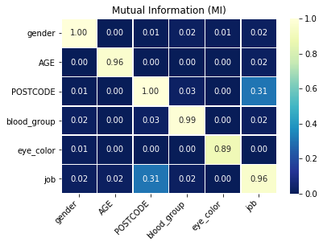
Mutual Information for PIF
Filename: PIF_v2.ipynb
Example shows the pairwise MI between any two features.
Note that since MI is symmetric the matrix of pairwise MI’s is symmetric.

Slide 5
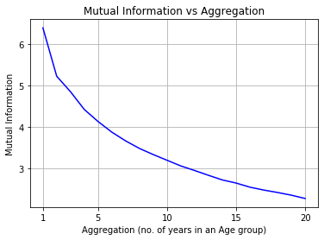
Mutual Information for Utility Factor
Filename: Utility_v2.ipynb
Age distribution of NSW population in 2017 was used as “original data”
To work out the aggregated data, the original age was rounded to the nearest N years where N ranges from 1 to 20 (see x-axis on the right).
Finally, an MI value (y-axis) was computed for each pair of Original Age and Aggregated Age

